Slide 1

National Poverty Reduction Strategy
By: Darryl Wolk
Policy Analyst OMSSA

Slide 2
The federal government catching up to provinces and municipalities
In 1989, the House of Commons unanimously resolved to eliminate child poverty by the year 2000.
Child and family poverty has increased to 1,331,530 children in 2012 from 1,066,150 children in 1989.
2008 recession and the 20th anniversary of the 1989 motion to end child poverty provided the urgency for a new study and consultations of poverty in Canada.
Advocates wanted the federal government to take a leadership role and establish a national poverty reduction strategy.
No long-term action plan was developed to meet this goal and monitor progress.

Slide 3
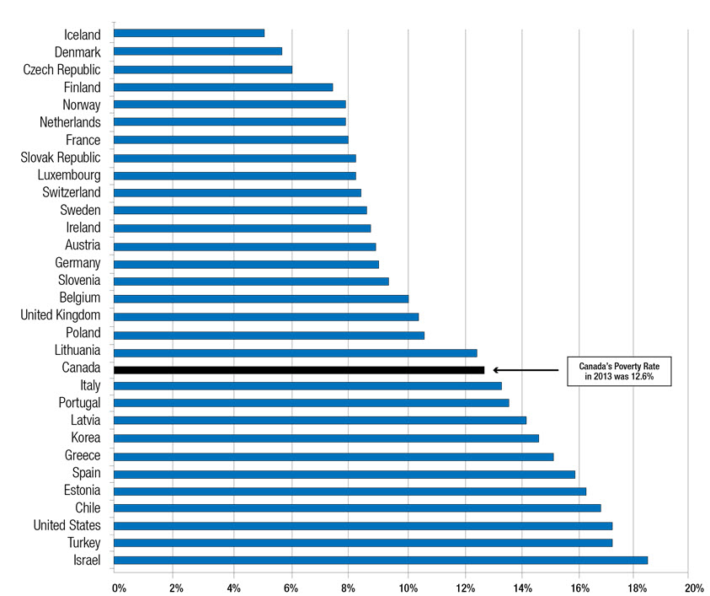
Poverty in Canada

Slide 4
Poverty in Canada
In 2014, 3 million Canadians, 8.8 percent of the population, lived in poverty. This included more than half a million children.
In 2014, about 746,000 Canadians lived in families that worked but were poor.
In 2014, Canada's low-income (poverty) rate for seniors was 3.9 percent.
In 2011, Over 655,000 Canadian households spent at least 50 percent of their income before taxes on housing. About 90 percent of these households were low-income.
Single people aged 45 to 64, single parents, recent immigrants, Indigenous people and people with disabilities are more likely to experience poverty.

Slide 5
Measure of Low Income in Canada
Low income cut-offs: 8.8% – 3.0 million Canadians
Market basket measure: 11.3% – 3.9 million Canadians
Low income measure: 13.0% – 4.5 million Canadians

Slide 6
Impacted groups in Canada
Children, lone parents (particularly female lone parents)
Women
Aboriginal people,
Persons with disabilities,
Immigrants (particularly recent immigrants)
Seniors
Rural and Northern
Unattached individuals

Slide 7
Child Poverty in Canada
Children Living in Poverty Rate: 19%
Indigenous Children Living in Poverty Rate: 40%
Youth Unemployment Rate: 13.2%
More than 1.34 million Canadian children — almost one in five — are living in poverty, a figure that has ballooned since 1989 when Parliament first vowed to eradicate the problem by the millennium. The pledge was repeated in 2009 and again earlier this year, but Ottawa has yet to develop a concrete plan to keep the promise. –Canada2020

Slide 8
Rural Poverty in Canada - Challenges
“Being poor in rural Canada means more than just not having enough. It also means having to travel long distances to get enough.” (Standing Senate Committee on Agriculture and Forestry 2006, p. 52)
Transportation and roads
Health and Access to Health Care
Education and Literacy
Government and Private-sector Services
Employment Issues
Hardships in Agriculture, Fisheries, Forestry and Mining etc.
Declining Populations & Demographics

Slide 9
Economic arguments on Poverty Reduction
Ontario Association of Food Banks found that poverty costs the government about $30 billion a year, much of which was health care expenditures because being poor frequently means poor health.
Numerous studies have found that it costs three to four times more to leave someone on the street (in and out of shelters, hospitals, jails) than to give them a home with support services.

Slide 10
Coordination with Provinces and Municipalities
Every province except British Columbia has or is in the process of drafting poverty-reduction strategies.
Many municipalities have local poverty reduction and homelessness plans.
Studied best practices in the UK and Ireland
The national housing strategy is being created with input from the provinces and local best practices. It is designed to compliment and support the provincial and local plans already in place.

Slide 11
Federal consultation questions
How do you define poverty? How should it be measured? Are there data gaps that need to be addressed to help improve our understanding of poverty in Canada?
What will success look like in a Poverty Reduction Strategy? What target(s) should we pick to measure progress?
Which indicators should we use to track progress towards the target(s)?
On which groups should we focus our efforts? Which dimensions of poverty should be prioritized?
Which Government of Canada programs and policies do you feel are effective at reducing poverty? Are there programs and policies that can be improved? What else could we do?
How can the Government of Canada align its Poverty Reduction Strategy so that it supports existing efforts by provinces, territories, municipalities and communities?
What are some initiatives/innovations in Canada or elsewhere that other governments, community organizations, academia, or businesses have introduced or proposed to effectively reduce poverty?
How can the Government encourage an on-going dialogue with other levels of government, community organizations, academia and businesses on its poverty reduction efforts?

Slide 12
Focus Areas in the National Poverty Reduction Strategy
Income
Housing and homelessness,
Jobs, training & the workplace
Higher education
Health
Mobility & equality of opportunity
Food Security
Faces of poverty

Slide 13
Status of the National Poverty Reduction Strategy
Minister of Families, Children and Social Development and The Standing Committee on Human Resources, Skills and Social Development and the Status of Persons with Disabilities responsible for the strategy.
1. Consulting – Consultations took place across the country in 2017
2. Poverty Advisory Committee – Appointed in June of 2017
3. Tackling Poverty Together 6 Community Study – Completed 2017
4. Report on Consultations – Due early 2018
5. National Poverty Reduction Strategy – Work in progress
6. Implementation - TBD

Slide 14
Mandate of the Poverty Advisory Committee
Identifying priority areas of action;
Aligning federal government actions to reduce poverty with those of the provinces and territories;
Replicating innovative approaches to poverty reduction at the national level.

Slide 15
National Housing Strategy Objectives
Reducing chronic homelessness by 50 per cent;
Removing more than 530,000 households from housing need;
Creating four times as many new housing units as built under federal programs from 2005 to 2015;
Repairing three times as many existing housing units as repaired under federal programs from 2005 to 2015; and
Protecting an additional 385,000 households from losing an affordable place to live.
Target groups include: seniors, Indigenous Peoples, survivors of family violence, people with disabilities, refugees, veterans, and those grappling with homelessness (at least 25% of funds go to projects for women, girls and their families).

Slide 16
National Housing Strategy Details
The National Housing Strategy – Canada's first ever – was developed through consultations with Canadians from all walks of life: people who have experienced barriers to good housing, experts, stakeholders, think tanks, as well as provinces and territories and municipalities.
Over the next 10 years, the Strategy – which will be in part funded jointly by the federal, provincial, and territorial governments – will help reduce homelessness and the number of families living in housing need, and will help strengthen the middle class.
Investment under the National Housing Strategy includes:
  $15.9-billion for a new National Housing Co-Investment Fund
  $8.6-billion for a new Canada Community Housing Initiative in partnership with provinces and territories, and $500 million through a new Federal Community Housing Initiative
  $4-billion for a new Canada Housing Benefit to be launched in 2020 in partnership with provinces and territories
  $2.2-billion to reduce homelessness
  $300-million in additional federal funding to address housing needs in Canada's North.
  $241-million for research, data and demonstrations.
In recognition of the significant amount of new housing units to be built and repaired through the federal Co-Investment Fund, the Strategy also includes ambitious targets to reduce greenhouse gas emissions, and ensure accessibility in building design.
The Government of Canada is also working with Indigenous leaders to co-develop distinctions-based housing strategies with First Nations, Inuit, and Métis Nation that will be founded on the principles of self-determination, reconciliation, respect, and cooperation.

Slide 17
Canadian successful outcomes
Guaranteed Income Supplement (GIS) and Old Age Security has been an important success story in reducing seniors poverty in Canada.
National Child Benefit Initiative was a successful tool in reducing some poverty in Canada. The National Child Benefit Supplement has potential to play an even greater role.

Slide 18
Previous Committee Recommendations
As the Canada Child Tax Benefit (CCTB) has clearly made an impact on poverty, the Committee recommends that the federal government incrementally increase the annual amount of the CCTB—including both the base benefit and the NCBS—to reach a minimum of $5,000 per child within five years’ time.
To assist people with disabilities, we recommend that the federal government immediately amend the Income Tax Act to make the Disability Tax Credit (DTC) a refundable credit.
As a first step to improving the living conditions of Aboriginal people, the Committee recommends that the Government of Canada endorse the United Nations Declaration on the Rights of Indigenous People.
Call on the federal government to preserve Canada’s existing affordable housing stock and to ensure that the measures announced in Budget 2009 for the construction of social housing units for low income seniors, people with disabilities, Aboriginal people, and areas of the North are promptly delivered.
Employment related measures, and contains recommendations pertaining to financial literacy, the social economy and other aspects related to education and training.

Slide 19
Other suggestions
Senator Art Eggleton has been exploring a basic income, better access to higher education and tax changes to address income inequality.
Ottawa should also earmark $500 million in emergency daycare funds to help provinces shore up regulated programs while developing a national early-learning and child-care framework and long-term federal funding.
An enhanced child benefit for low-income families to a maximum of $5,600 per child (2014 dollars, indexed to inflation) by streamlining support to families through the taxation and transfer systems.
Proactive strategies, including employment equity in the public and private sectors, and a sensible training strategy accessible to those not on EI to level the playing field for racialized communities and other historically disadvantaged groups.
A national Early Childhood Education and Care program, led by the federal government and developed collaboratively with provinces/territories and indigenous communities, which includes a well-developed policy framework based on the principles of universality, high quality and comprehensiveness.

Slide 20
Liberal Campaign Promise
“Our plan will lift Canadians out of poverty starting immediately after the next election.
We will introduce a new Canada Child Benefit. Tax-free, tied to income and delivered monthly, this benefit provides greater support to those who need help most: single-parent families and low-income families. It will lift 315,000 children out of poverty.
We will help to lift hundreds of thousands of seniors out of poverty by increasing the Guaranteed Income Supplement for single low-income seniors by ten percent. This will give one million of our most vulnerable seniors – who are often women – almost $1,000 more each year.
And, as part of our new investment in social infrastructure, we will prioritize investments in affordable housing and seniors’ facilities, build more new housing units and refurbish old ones, give support to municipalities to maintain rent-geared-to-income subsidies in co-ops, and give communities the money they need for Housing First initiatives that help homeless Canadians find stable housing.”

Slide 21
Federal accomplishments since 2015 Election
Introduced the Canada Child Benefit, which is tax-free and provides up to $6,400 annually per child under the age of six and $5,400 annually per child aged 6–17.
Working with the provinces, the territories and experts to develop a framework on early learning and child care to address the need for access to affordable, high-quality child care.
Develop a strategy against gender-based violence.
Increased the Old Age Security and the Guaranteed Income Supplement top-up for low-income single seniors by $947 per year.
Cancelled the age of eligibility increase from 65 to 67 for Old Age Security and the Guaranteed Income Supplement.
Reached an agreement-in-principle with provincial governments to expand the Canada Pension Plan. This expansion will ensure that the Canada Pension Plan replaces 33% of Canadians’ incomes in retirement, up from the current rate of 25%. It will also ensure that more income is subject to Canada Pension Plan contributions.
Committed to increase the Working Income Tax Benefit to ensure that lower-income workers have larger Canada Pension Plan benefits in retirement without feeling the burden today. This benefit provides tax relief for eligible, working low-income individuals and families who are already in the workforce, and encourages other Canadians to enter the workforce. The enhancement will provide a higher benefit and reach more working-poor Canadians.

Slide 22
Federal accomplishments since 2015 Election
Developing a National Housing Strategy. Among other things, the National Housing Strategy will aim to reduce core housing need; reduce the gap in core housing need between renters and homeowners; and reduce the incidence of severe housing need.
Investing an additional $504.4 million over two years in the Investment in Affordable Housing program. Under this initiative, provinces and territories match federal investments and have the flexibility to design and deliver programs tailored to local housing needs and pressures.
Investing an additional $111.8 million over two years in the Homelessness Partnering Strategy.
Investing $200.7 million over two years to increase affordable housing for seniors.
Support shelters for victims of family violence by investing $89.9 million over two years.
Providing $573.9 million over two years towards the renovation of existing social housing.
Investing $208.3 million over five years towards an Affordable Rental Housing Innovation Fund to help encourage the construction of affordable rental housing.

Slide 23
Federal Accomplishments since 2015 Election
Developing accessibility legislation. This legislation will be developed following consultations with stakeholders, most importantly Canadians with disabilities. Consultations will explore who should be covered by the legislation, what accessibility issues and barriers should be addressed, how it could be monitored and enforced and how to raise awareness to improve accessibility.
Committed to reinstate the Court Challenges Program of Canada to ensure that vulnerable groups have improved access to the justice system and confirm their constitutional rights under the Canadian Charter of Rights and Freedoms.
Working with its partners to develop a Social Innovation and Social Finance Strategy to support community organizations working to tackle persistent social challenges in new, innovative ways.
Developing and negotiating a health accord with provincial and territorial governments aimed at transforming key parts of Canada’s health care system.
Providing additional funding of $64.5 million for five years, as well as $13.8 million per year ongoing, to expand Nutrition North Canada to additional isolated northern communities.
Increased Canada Student Grants for low- and middle-income students from $2,000 to $3,000 a year.
Improved the Canada Student Loans Program to better meet the needs of low-income students. Starting in 2017, students will contribute a fixed amount toward the costs of their education. In return, their financial assets and student income will not be considered.
Changed the repayment rules for the Canada Student Loans Program so that graduates with loans will only have to start repaying their loans when they begin to earn at least $25,000 a year.
Improved access to the Canada Learning Bond for children from low-income families.

Slide 24
Federal Accomplishments since 2015 Election
Reduced Employment Insurance premiums, effective 2017.
Working to reduce the waiting period to enhance income support through Employment Insurance.
Eliminated higher eligibility requirements to the Employment Insurance program for the New-Entrant and Re-Entrant to the Labour Market categories.
Extended the Employment Insurance program’s Working While on Claim pilot and working to develop a long-term solution.
Temporarily extended Employment Insurance benefits to regions that have experienced significant job losses as a result of the commodity price decline.
Committed to enhance parental and caregiving benefits delivered through Employment Insurance.
Invested an additional $125 million in 2016–17 in the Labour Market Development Agreements and an additional $50 million in 2016–17 in the Canada Job Fund Agreements to support training and skills development.
Introduced initiatives to promote good-quality jobs and decent work in the federally regulated private sector.
Invested $4 million in 2016–17 to extend the Northern Adult Basic Education Program for one year while the Government reviews the program with a view to determine how best to support the participation of Northerners in the labour market.

Slide 25
Thank you very much
Questions or comments?
Darryl Wolk
dwolk@omssa.com
Policy Analyst
Ontario Municipal Social Services Association

