Slide 1


Slide 2
DC MOVES Survey Results
June 2016 and June 2018
25 and 46 participants
Other notes, comments and observations

Slide 3
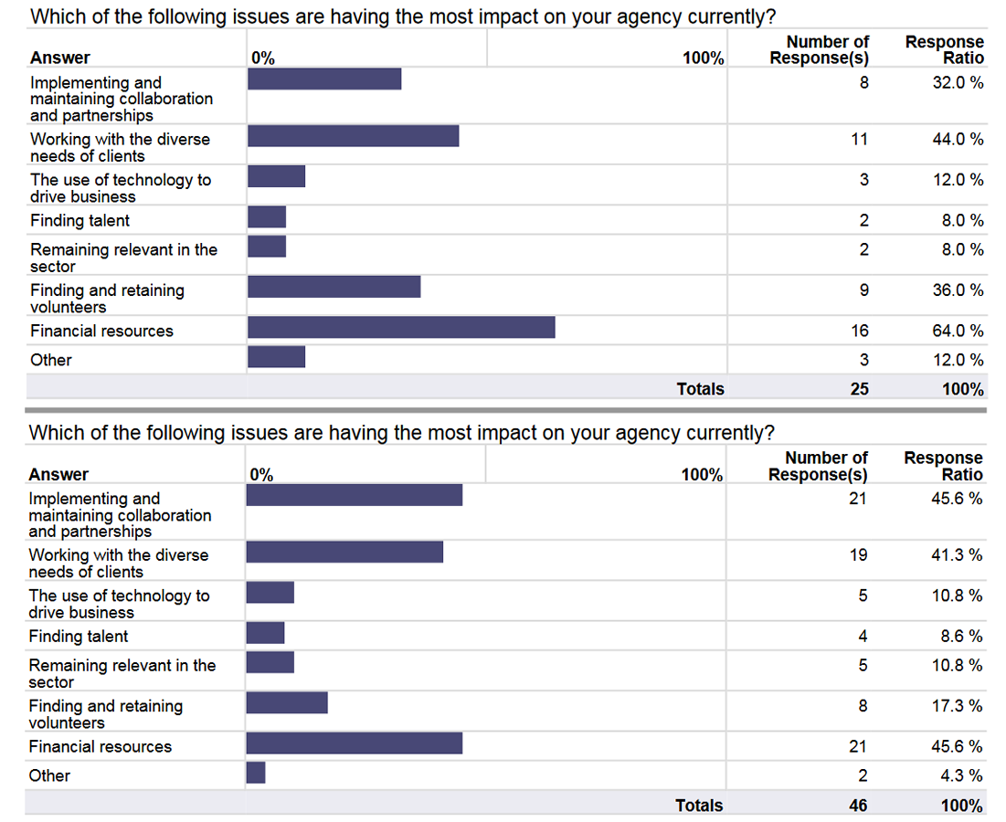

Slide 4
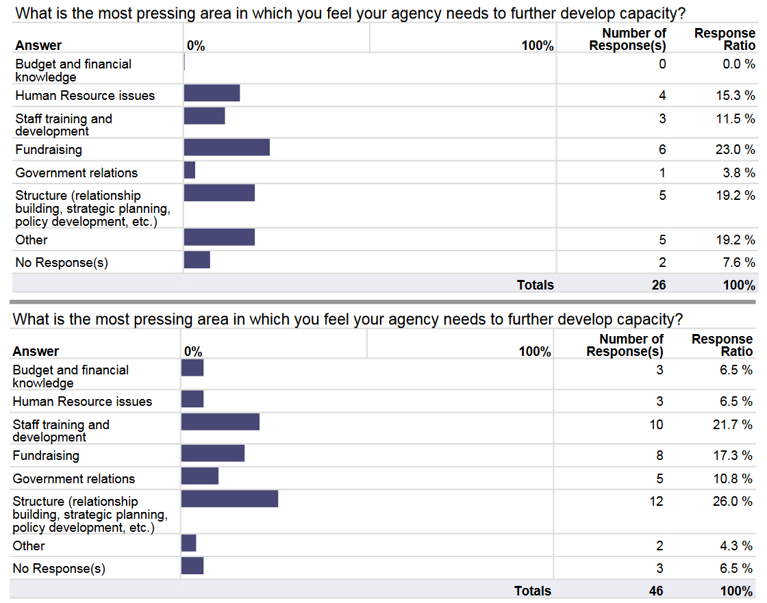

Slide 5
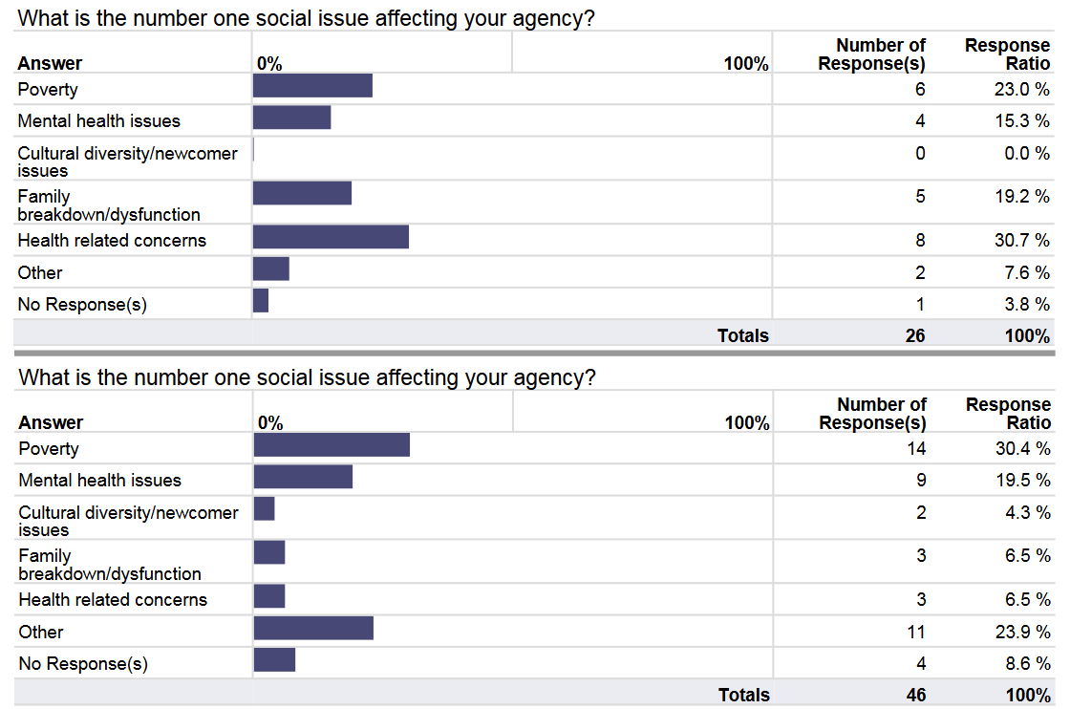

Slide 6
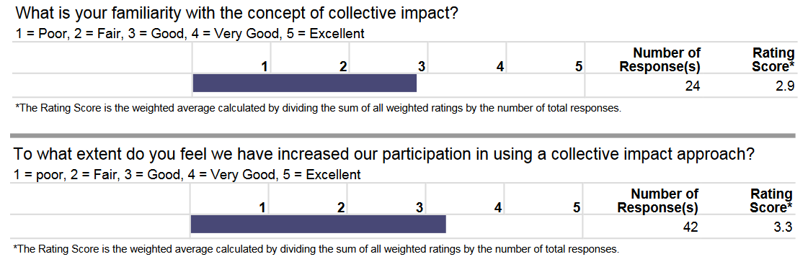

Slide 7
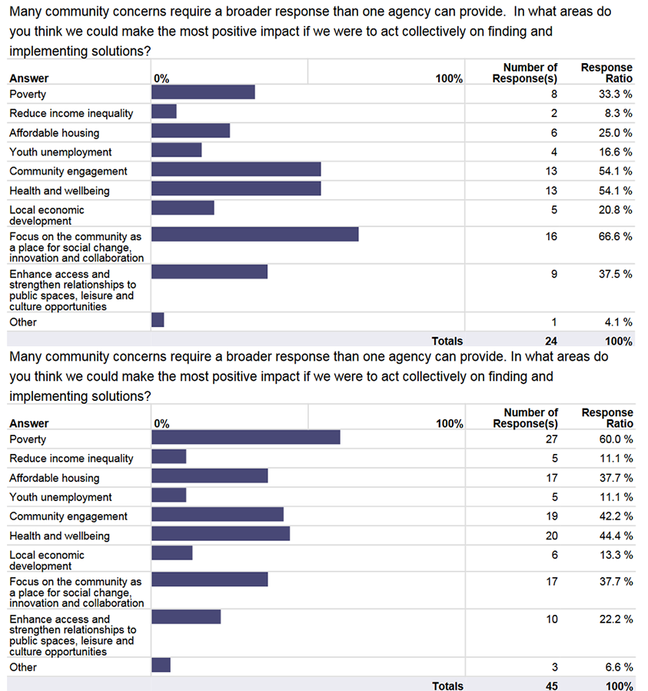

Slide 8


