Slide 1


The Poverty Task Force Experience:
Our Work & Journey with Peer Involvement
Presentation to Dufferin County Equity Collaborative
Thursday, November 14, 2019

Slide 2
Poverty will be eliminated in Guelph-Wellington.
THE POVERTY TASK FORCE
To work collaboratively, informed by diverse voices of experience, to take local action and advocate for system and policy change to address the root causes of poverty.

Slide 3
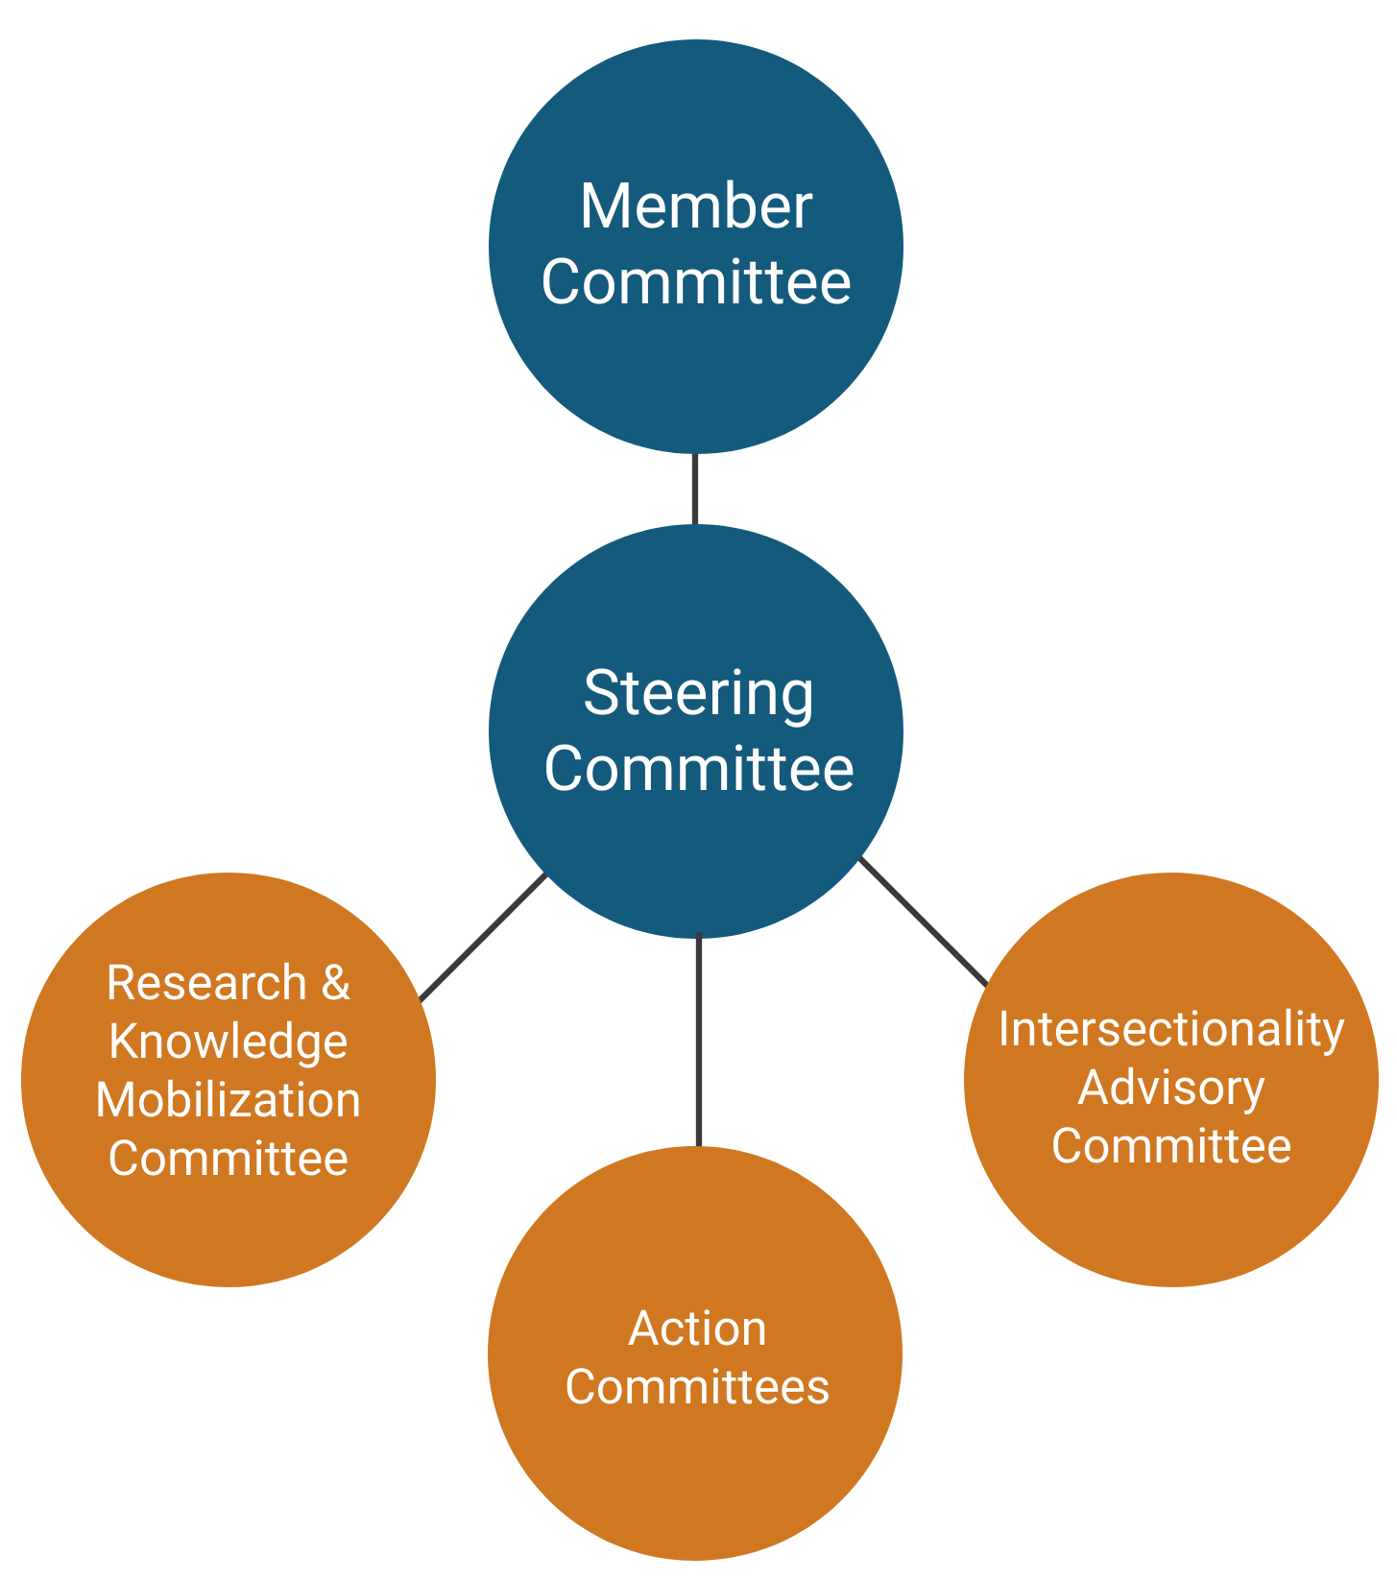
THE POVERTY TASK FORCE
Notes:
Engagement of key players and individuals with lived experience is what makes our work possible.

Slide 4

PATHWAYS:
Mechanisms used to affect change.
  Advocate & Inform
  Collaborate & Involve
  Communicate & Engage
  Research & Mobilize Knowledge
THE POVERTY TASK FORCE
Notes:
We work on these issues through 4 pathways:
First, We Advocate & Inform: We inform key players about local needs and priorities and advocate for system and policy change.
We Collaborate & Involve: We involve key players in poverty elimination efforts and work collaboratively through convening key players to address priority issues.
We Communicate & Engage: We increase awareness about poverty issues to shift attitudes and further solutions to issues.
Lastly, We Research & Mobilize Knowledge: It’s important to us that our work is evidence informed, so we conduct community-based research to deepen our understanding of issues and share that knowledge to inform change.

Slide 5




PRIORITY AREAS:
THE POVERTY TASK FORCE
Livable Incomes
& Decent Work
Homelessness
& Housing
Food
Insecurity
Health
Inequities
Notes:
Currently, the PTF focuses on 4 priority areas:
Housing & Homelessness: This includes our work on ending homelessness in our community through Built for Zero and work advocating for housing for low-income community members.
Decent Work & Livable Incomes: This includes are work advocating for fair wages and fair working conditions, calculating the living wage for our community, and advocating for increased social assistance rates.
Food Insecurity: We recognize that food insecurity is the inadequate or insecure access to food because of financial constraints. For this reason, we largely advocate for income-based solutions under this priority.
Health Inequities: We’ve focused in a number of areas under this priority, but most notably in recent years we’ve focused on advocating for oral health for low-income community members.

Slide 6



2019 PTF ACTIONS:
        Intersectional Approach
        Federal Election – Candidate Q&A, fact sheets, etc.
        Storied Lives Project
Living Wage – Employer recognition program
Income Security – Social assistance, basic income, etc.
        Decent Work Project
          – Fair wages & working conditions
          – Peer leader training
          – Community conversations & trainings
THE POVERTY TASK FORCE

Slide 7



2019 PTF ACTIONS:
        Housing crisis – Increase awareness
        Housing Access Guide – Update
        Yes In My Backyard (YIMBY) – Launch campaign
Built for Zero (20K Homes) – End chronic homelessness
Advocate for Permanent Supportive Housing
Report on Indigenous Homelessness
Cold & Warm Weather Response
        Food Access Guide – Update
        Healthy & Culturally Appropriate Food Policies
        Oral Health Care – Advocate for increased access
        Advocate for Pharmacare
THE POVERTY TASK FORCE

Slide 8

VALUES:
Lived experience
Equity, inclusion & social justice
Evidence-informed approach
Adaptability & responsiveness
THE POVERTY TASK FORCE
Notes:
We value lived experience. We believe that peers are experts in their own experience and provide important perspectives and a reality check. We are committed to meaningfully involving peers in the planning, delivery and evaluation of our work.
We recognize the intersectionality and interlocking of oppressions and seek to address these realities in our work. We are committed to the principles of equity, inclusion, and social justice.
We believe in an evidence-informed approach. This includes learning from the lessons found in traditional academic literature, less formal ‘grey literature’ like organizational or government reports, and the lived experience of professionals, service users, community members, and everyone in between.
We understand that being adaptable and responsive is our advantage. We work with people, communities, and partnerships, and on priority issues, that are complex and always changing. Our impact depends on our ability to anticipate change and adapt and respond in a way that furthers our mission.

Slide 9
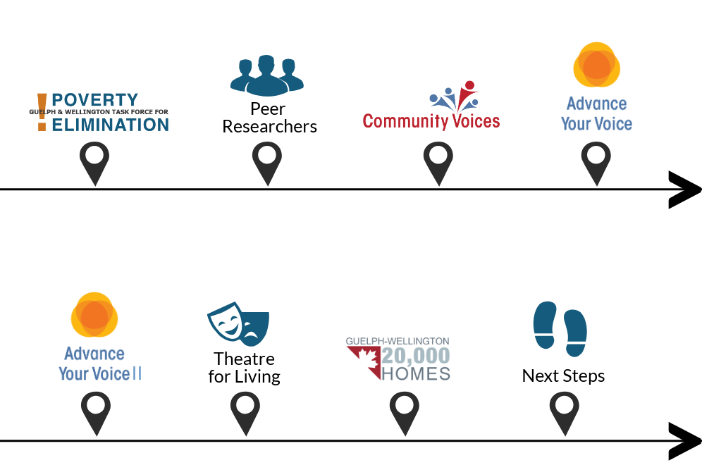
PEER INVOLVEMENT & THE POVERTY TASK FORCE:
Involvement from the start
Peer researchers
Community Voices
Advance Your Voice Speakers Bureau
  Focus on poverty
WHAT WE’VE DONE

Slide 10
PEER INVOLVEMENT & THE POVERTY TASK FORCE:
Advance Your Voice II
  Focus on homelessness
Theatre for Living
Point-in-Time Count
Next Steps: Increasing involvement & support
WHAT WE’VE DONE

Slide 11

1. THE IMPORTANCE OF SUPPORTS:
Basic supports
  Transportation,
  Childcare
  Food
Beyond the basics
  Honorariums
  Check-ins
  Frequent breaks
  Reminders
  Awareness of capacity & pressure
WHAT WE LEARNED

Slide 12
2. PARTICIPATION VS. MEANINGFUL PARTICIPATION:
Tokenism = participation without power
Budgets are about priorities
  Honorariums to value time & energy
Minimizing barriers
  Unrealistic expectations
  Training & support
  Flexibility
  Learning styles
  Language
Emotional support
  Staff capacity
WHAT WE LEARNED

Slide 13
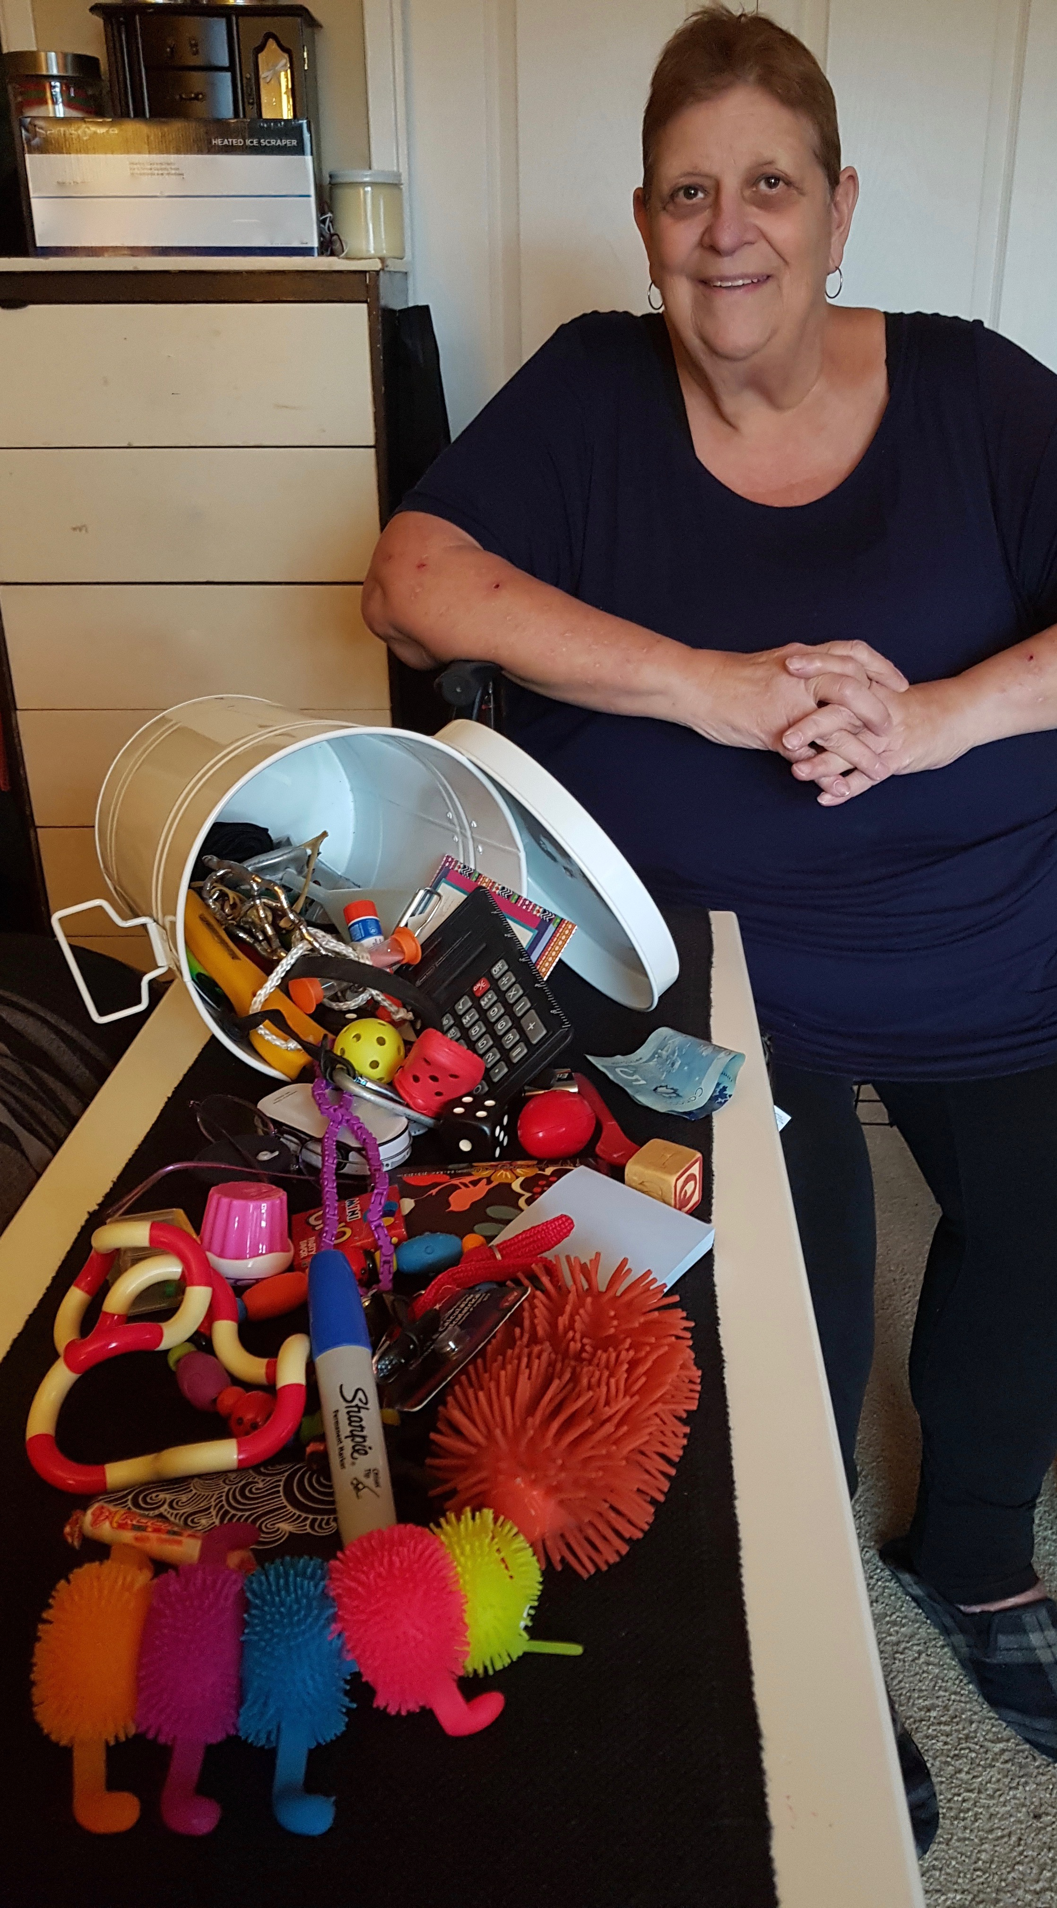
BARB’S BUCKET ACTIVITY

Slide 14
3. THE POWER OF PEERS:
Experts in experience
Advocacy & storytelling
Community Researchers
Outreach
Facilitators & Trainers
And more!
WHAT WE LEARNED

Slide 15
3. THE IMPORTANCE OF EQUITY & INTERSECTIONALITY:
Commitment to intersectional approach:
  Training
  Relationship building
  Formalizing practices
  Gaining a better understanding of poverty
WHAT WE LEARNED
Notes:
In June 2017 the PTF Member Committee made a unanimous decision to work toward adopting an intersectional approach. The PTF made this commitment to intentionally recognize how someone’s identities, such as gender and race, and the oppression or privilege they experience as a result, impacts how they navigate life and the degree to which they may experience issues, such as poverty.
Since making this commitment, we have been undergoing a review of our organization from this lens looking first at the importance of training and next at our membership and how we might shift it to be more representative of the diversity of experiences in our community when it comes to poverty.

Slide 16
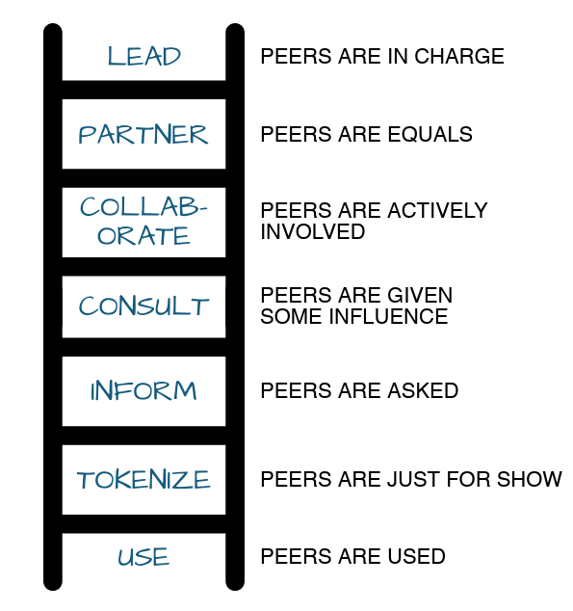
PEERS: Individuals with lived experience of an issue.
LADDER OF PEER ENGAGEMENT

Slide 17
Thank you for having us join you!
Questions?
Questions & Closing
Barb McPhee, PTF Peer Leader, Tina Brophey, PTF Peer Leader &
Dominica McPherson, Coordinator
www.gwpoverty.ca
info@gwpoverty.ca
1-800-265-7293

