Slide 1



Getting to Impact

Slide 2
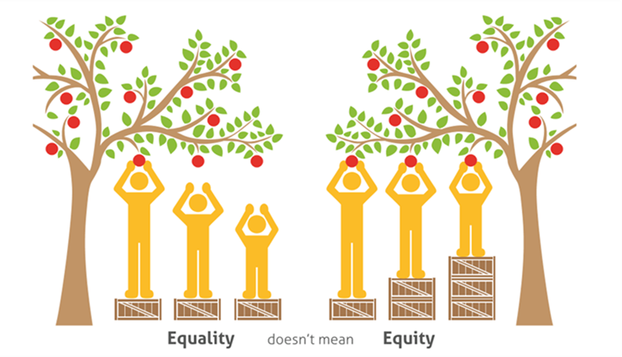
Getting to Impact
why are we doing this?

Slide 3
Getting to Impact
Process
Julie and Elaine responsible for the project of impact reporting:
Participating in 6 GTI learning modules
Applying the learning to our situation
Reporting / discussing progress with the Co-Chairs following each module
Sharing learning with the larger Collaborative
Working with the three priority outcome work groups to share the learning and collect their sharable data
Creating the Impact Report, presenting to the Co-Chairs
Supporting the DC Co-Chair in reporting to County Committee and Council (Nov/Dec)
Developing a Community Communication Strategy - NEXT step

Slide 4
Getting to Impact
What are we doing differently to report on impact?
First report on Impact, and from an informed positon as a result of participation in GTI series
Clarity - on many levels which will help shape our roadmap and future actions
Inform our strategy and clarify the path from short-to-long term outcomes
Language - establishing common language & consistency of language use

Slide 5
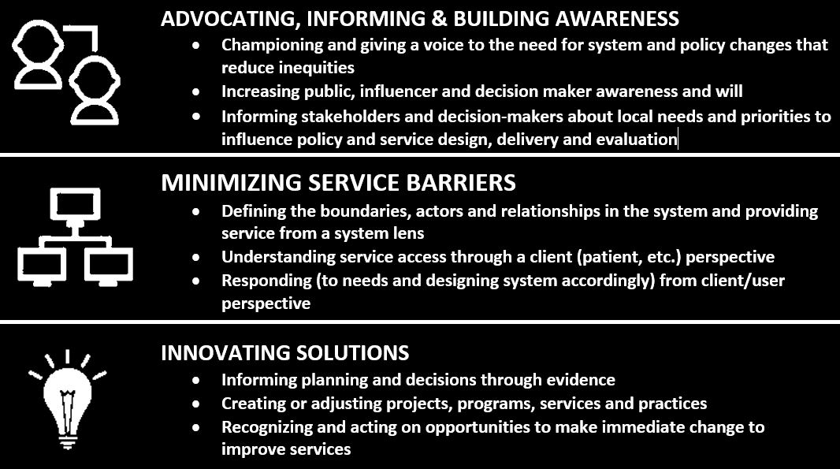



OUR FRAMEWORK
THEORY OF CHANGE: Advocating & Informing + Minimizing Service Barriers + Innovative Solutions (over time) = IMPACTS ON EQUITY

Slide 6
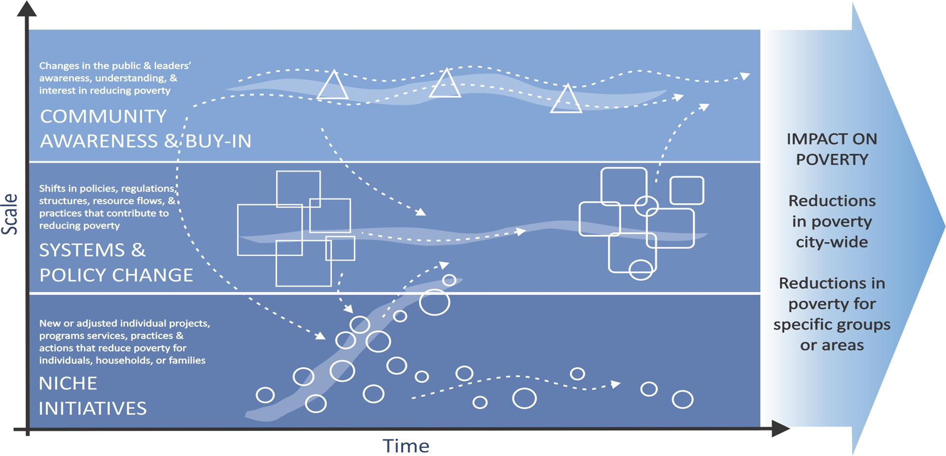
GTI FRAMEWORK
Outcomes
Impact

Slide 7
GTI FRAMEWORK + OUR FRAMEWORK
OUTCOMES
Housing & Homelessness
Employment
Health Equity
 | ADVOCATING & INFORMING (AWARENESS & BUY-IN) Champion and give voice to the need for system and policy changes that reduce inequities Inform stakeholders and decision-makers about local needs and priorities to influence policy and service design, delivery and evaluation
 | MINIMIZING SERVICE BARRIERS (SYSTEMS & POLICY CHANGE) Provide service from a system lens Understand service access through a client (patient, etc.) perspective Responding (to needs and designing system accordingly) from client perspective
 | INNOVATING SOLUTIONS (NICHE INITIATIVES) Evidence informed planning and decisions Action Orientated Recognise and act on opportunities to make immediate change to improve service access
IMPACT ON EQUITY
Every resident of Dufferin County will have the opportunity to reach their full potential.
SCALE
TIME

Slide 8
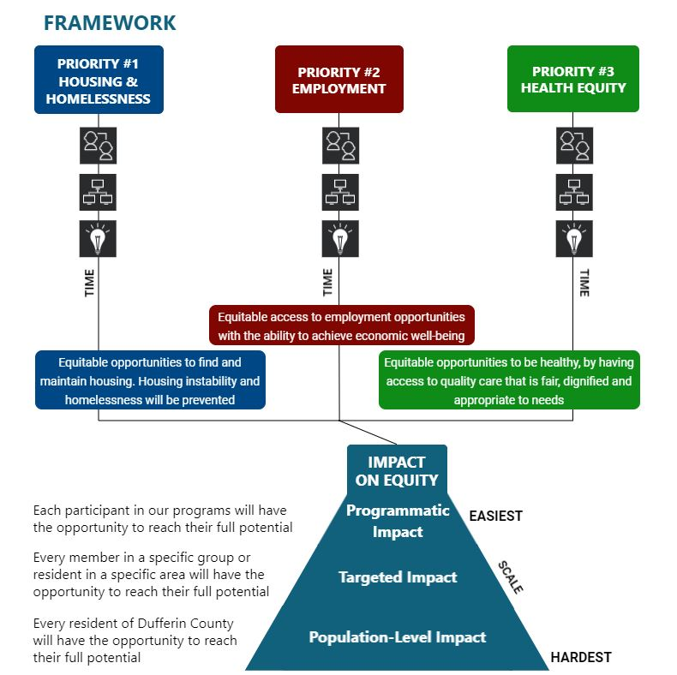
Getting to Impact

Slide 9
Getting to Impact
What have been the major challenges so far?
Contribution vs. Attribution way of thinking
Applying Systems thinking & identifying Leverage points crucial for systems change
Clarifying what we should be measuring; who has what data, at what level
Going back-and-forth with the strategy and evaluation framework
Determining what are the most urgent and important outcomes and impacts to communicate

Slide 10
Getting to Impact
What are some outcomes we are excited to report this year?
We are working as a collective: we have a common agenda; working on shared measurement; we have examples of mutually reinforcing activity; we have continuous communication; we have a backbone
We have an Impact Report
We have Stories of Success
We have beginning OUTCOMES in each priority area

Slide 11
Getting to Impact
What are we excited to upgrade/report next year?
Expand the collaborative to include the voice of L/L E subject experts
Continue to strengthen collaboration with members and partners
Increase and align data for more meaningful reporting and fill gaps
Increase clarity of desired outcomes and impacts
Move forward on medium and long term actions
Drive the Roadmap specifics for 2020 and beyond

Slide 12
Getting to Impact
THANK YOU to the Tamarack Institute and Cities Reducing Poverty team for inviting us to take part in this rich and valuable learning opportunity to develop our community impact report, and for their gracious mentorship in bringing us along the path to today
We are truly grateful !

