Slide 1




Welcome to our 1st Year in review

Slide 2
Agenda
Check-in - Who’s in the room – name and organisation
Call for declaration of conflict of interest
Confirmation of ToR
Co-chairs ‘ welcome and update on the landscape

Slide 3
Agenda
Guest speakers from the PTF Guelph Wellington
Secondary Suites panel of experts
Getting to Impact
Media update
What's next

Slide 4
Guest Speakers
Welcome to our guests from the PTF Guelph Wellington

Slide 5
Secondary Suites
Panel of experts:
Jenny Li, Planning Coordinator, County of Dufferin
Carol Barber, Program Manager, Housing Services, County of Dufferin
Guy Gardhouse, Mayor, East Garafraxa, and County Councillor
Questions
? what are secondary suites,
? how does this help our housing mix/ address attainable housing,
? what’s happening from the planning perspective – updating the new legislation in the County OP and lower tier OPs, getting from language to reality,
? how do people go about making them official,
? what can we do to encourage secondary suites

Slide 6
Getting to Impact
Presentation
Community Impact Report

Slide 7
Media Update
Review of web content
Web & social media stats

Slide 8
What’s Next
Roadmap refresh and Community Impact report next steps

Slide 9
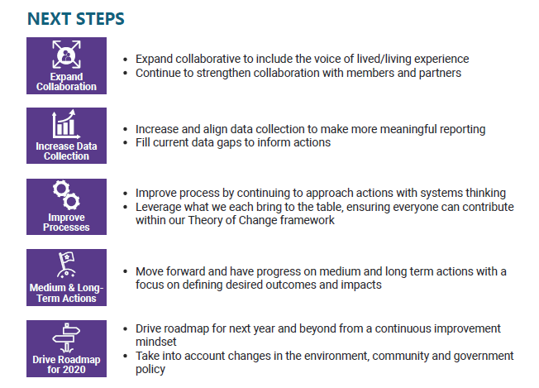
What’s Next

Slide 10
What’s Next
Announcements:
LLE working committee
Housing Forum Nov 22 and Housing survey
Next large group meeting date - January 30th 8:30 to 12

